Slide 1

No Metrics Are Perfect: Adversarial REward Learning for Visual Storytelling
Xin (Eric) Wang*, Wenhu Chen*, Yuan-Fang Wang, William Wang

Slide 2
Image Captioning
Caption:
Two young kids with backpacks sitting on the porch.

Slide 3
Visual Storytelling
Story:
The brother did not want to talk to his sister. The siblings made up. They started to talk and smile. Their parents showed up. They were happy to see them.
Story:
The brother did not want to talk to his sister. The siblings made up. They started to talk and smile. Their parents showed up. They were happy to see them.
Story:
The brother did not want to talk to his sister. The siblings made up. They started to talk and smile. Their parents showed up. They were happy to see them.
Imagination
Emotion
Subjectiveness

Slide 4
Visual Storytelling
Story #2:
The brother and sister were ready for the first day of school. They were excited to go to their first day and meet new friends. They told their mom how happy they were. They said they were going to make a lot of new friends. Then they got up and got ready to get in the car.

Slide 5
Behavioral cloning methods (e.g. MLE)
are not good enough for visual storytelling

Slide 6
Reinforcement Learning
Directly optimize the existing metrics
BLEU, METEOR, ROUGE, CIDEr
Reduce exposure bias
Environment
Reward Function
Reinforcement Learning (RL)
Optimal Policy
Rennie 2017, “Self-critical Sequence Training for Image Captioning”

Slide 7
We had a great time to have a lot of the. They were to be a of the. They were to be in the. The and it were to be the. The, and it were to be the.
Average METEOR score: 40.2
(SOTA model: 35.0)

Slide 8
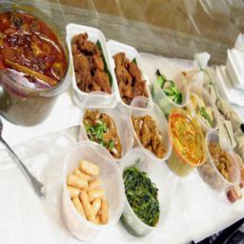
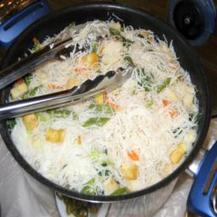
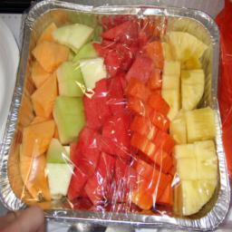
I had a great time at the restaurant today. The food was delicious. I had a lot of food. I had a great time.
BLEU-4 score: 0

Slide 9
No Metrics Are Perfect!

Slide 10
Inverse Reinforcement Learning
Reinforcement Learning
Environment
Environment
Reward Function
Reward Function
Inverse Reinforcement Learning (IRL)
Reinforcement Learning (RL)
Optimal Policy
Optimal Policy

Slide 11
Adversarial REward Learning (AREL)
Environment
Reference
Story
Adversarial Objective
Reward Model
Generated Story
Policy Model
Inverse RL
Reward
RL

Slide 12

Policy Model $π_{β}$
CNN
My brother recently graduated college.
It was a formal cap and gown event.
My mom and dad attended.
Later, my aunt and grandma showed up.
When the event was over he even got congratulated by the mascot.
Encoder
Decoder

Slide 13

Reward Model $R_{θ}$
CNN
+
my
mom
and
dad
attended
.
<EOS>
Reward
Story
Convolution
Pooling
FC layer
Kim 2014, “Convolutional Neural Networks for Sentence Classification”

Slide 14
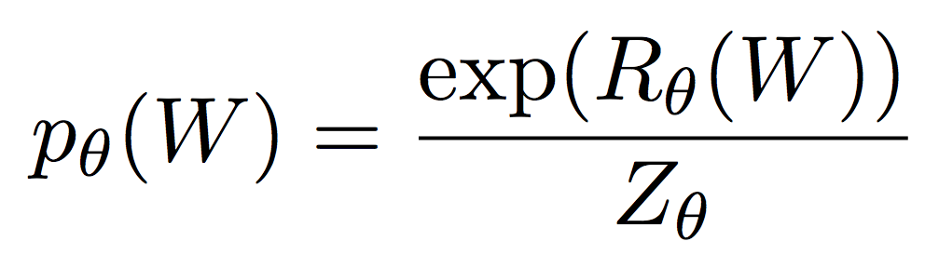
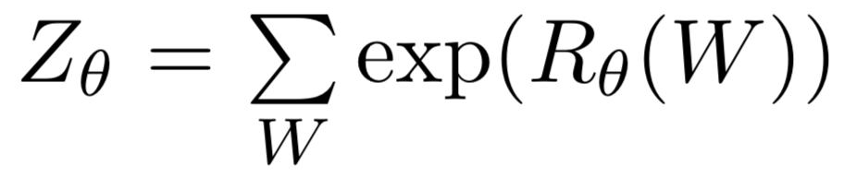
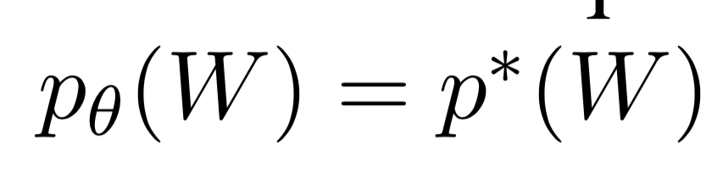
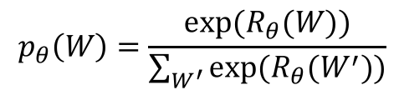
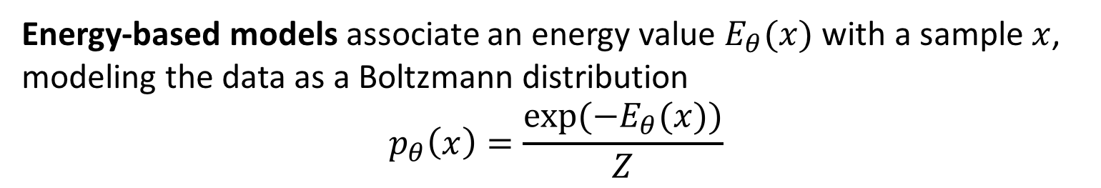
Associating Reward with Story
Energy-based models associate an energy value $E_{θ}(x)$ with a sample $x$, modeling the data as a Boltzmann distribution
$$p_{θ}\left(x\right)=\frac{exp⁡({−E}_{θ}(x))}{Z}$$
Reward Boltzmann Distribution
Story
Reward Function
Approximate data distribution
Partition function
Optimal reward function $R_{θ}^{∗}(W)$ is achieved when
LeCun et al. 2006, “A tutorial on energy-based learning”
$$p_{θ}\left(W\right)=\frac{exp⁡(R_{θ}(W))}{\sum_{W^{′}}{exp⁡(R_{θ}(W^{′}))}}$$

Slide 15

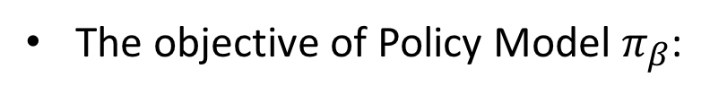
AREL Objective
Therefore, we define an adversarial objective with KL-divergence
Reward Boltzmann distribution
Empirical distribution
Policy distribution
The objective of Reward Model $R_{θ}:$
The objective of Policy Model $π_{β}$:

Slide 16
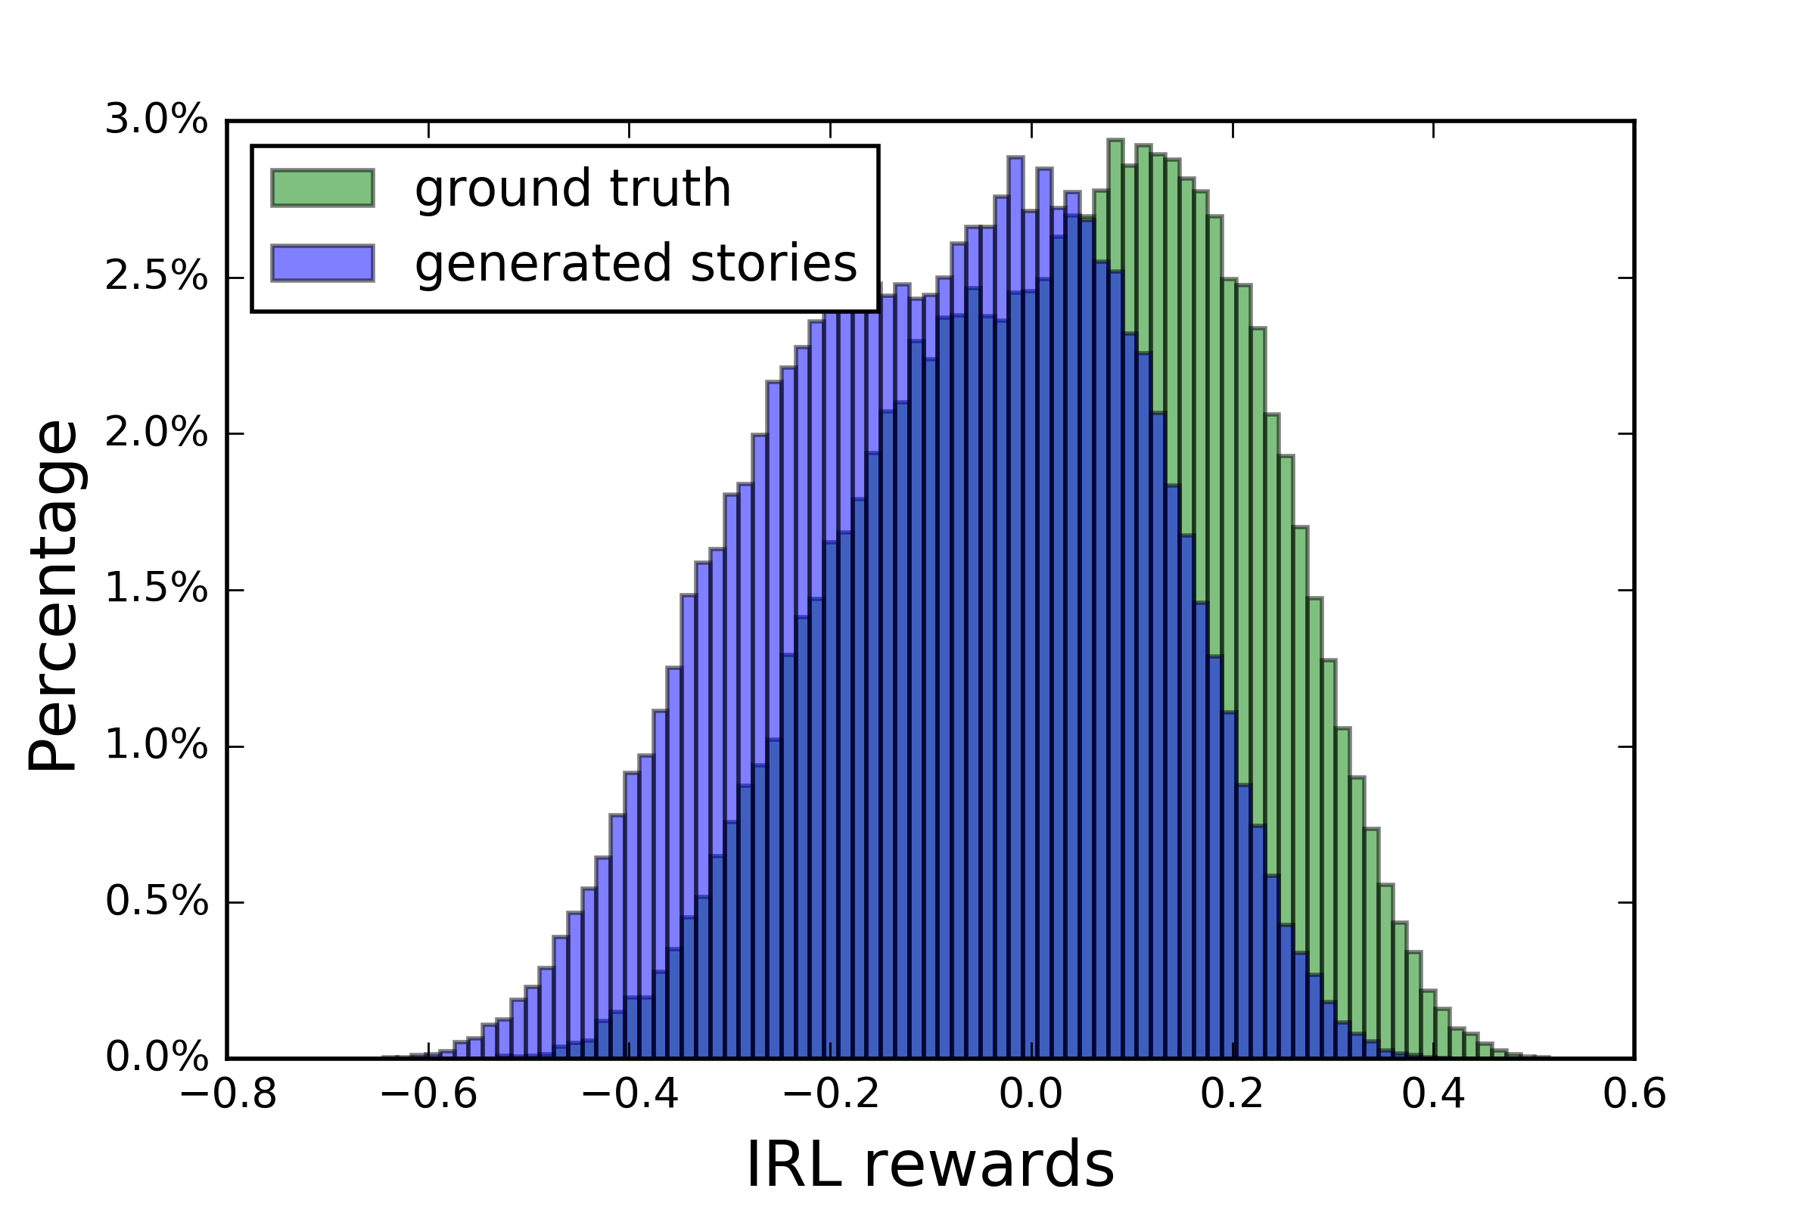
Reward Visualization

Slide 17
Automatic Evaluation
Method | BLEU-1 | BLEU-2 | BLEU-3 | BLEU-4 | METEOR | ROUGE | CIDEr
Seq2seq (Huang et al.) | - | - | - | - | 31.4 | - | -
HierAttRNN (Yu et al.) | - | - | 21.0 | - | 34.1 | 29.5 | 7.5
AREL (ours) | 63.7 | 39.0 | 23.1 | 14.0 | 35.0 | 29.6 | 9.5
Method | BLEU-1 | BLEU-2 | BLEU-3 | BLEU-4 | METEOR | ROUGE | CIDEr
Seq2seq (Huang et al.) | - | - | - | - | 31.4 | - | -
HierAttRNN (Yu et al.) | - | - | 21.0 | - | 34.1 | 29.5 | 7.5
XE | 62.3 | 38.2 | 22.5 | 13.7 | 34.8 | 29.7 | 8.7
BLEU-RL | 62.1 | 38.0 | 22.6 | 13.9 | 34.6 | 29.0 | 8.9
METEOR-RL | 68.1 | 35.0 | 15.4 | 6.8 | 40.2 | 30.0 | 1.2
ROUGE-RL | 58.1 | 18.5 | 1.6 | 0.0 | 27.0 | 33.8 | 0.0
CIDEr-RL | 61.9 | 37.8 | 22.5 | 13.8 | 34.9 | 29.7 | 8.1
GAN | 62.8 | 38.8 | 23.0 | 14.0 | 35.0 | 29.5 | 9.0
AREL (ours) | 63.7 | 39.0 | 23.1 | 14.0 | 35.0 | 29.6 | 9.5
Method | BLEU-1 | BLEU-2 | BLEU-3 | BLEU-4 | METEOR | ROUGE | CIDEr
Seq2seq (Huang et al.) | - | - | - | - | 31.4 | - | -
HierAttRNN (Yu et al.) | - | - | 21.0 | - | 34.1 | 29.5 | 7.5
XE | 62.3 | 38.2 | 22.5 | 13.7 | 34.8 | 29.7 | 8.7
AREL (ours) | 63.7 | 39.0 | 23.1 | 14.0 | 35.0 | 29.6 | 9.5
Method | BLEU-1 | BLEU-2 | BLEU-3 | BLEU-4 | METEOR | ROUGE | CIDEr
Seq2seq (Huang et al.) | - | - | - | - | 31.4 | - | -
HierAttRNN (Yu et al.) | - | - | 21.0 | - | 34.1 | 29.5 | 7.5
XE | 62.3 | 38.2 | 22.5 | 13.7 | 34.8 | 29.7 | 8.7
BLEU-RL | 62.1 | 38.0 | 22.6 | 13.9 | 34.6 | 29.0 | 8.9
METEOR-RL | 68.1 | 35.0 | 15.4 | 6.8 | 40.2 | 30.0 | 1.2
ROUGE-RL | 58.1 | 18.5 | 1.6 | 0.0 | 27.0 | 33.8 | 0.0
CIDEr-RL | 61.9 | 37.8 | 22.5 | 13.8 | 34.9 | 29.7 | 8.1
AREL (ours) | 63.7 | 39.0 | 23.1 | 14.0 | 35.0 | 29.6 | 9.5
Method | BLEU-1 | BLEU-2 | BLEU-3 | BLEU-4 | METEOR | ROUGE | CIDEr
Seq2seq (Huang et al.) | - | - | - | - | 31.4 | - | -
HierAttRNN (Yu et al.) | - | - | 21.0 | - | 34.1 | 29.5 | 7.5
XE | 62.3 | 38.2 | 22.5 | 13.7 | 34.8 | 29.7 | 8.7
BLEU-RL | 62.1 | 38.0 | 22.6 | 13.9 | 34.6 | 29.0 | 8.9
METEOR-RL | 68.1 | 35.0 | 15.4 | 6.8 | 40.2 | 30.0 | 1.2
ROUGE-RL | 58.1 | 18.5 | 1.6 | 0.0 | 27.0 | 33.8 | 0.0
CIDEr-RL | 61.9 | 37.8 | 22.5 | 13.8 | 34.9 | 29.7 | 8.1
AREL (ours) | 63.7 | 39.0 | 23.1 | 14.0 | 35.0 | 29.6 | 9.5
Huang et al. 2016, “Visual Storytelling”
Yu et al. 2017, “Hierarchically-Attentive RNN for Album Summarization and Storytelling”

Slide 18
Human Evaluation
-6.3
-17.5
-13.7
-26.1

Slide 19
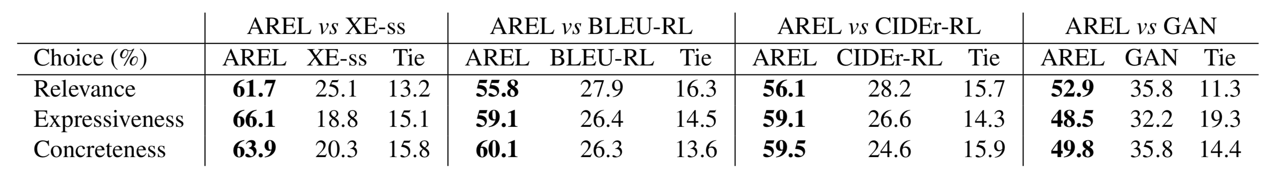
Human Evaluation
Pairwise Comparison
Relevance: the story accurately describes what is happening in the photo stream and covers the main objects.
Expressiveness: coherence, grammatically and semantically correct, no repetition, expressive language style.
Concreteness: the story should narrate concretely what is in the images rather than giving very general descriptions.

Slide 20
XE-ss | We took a trip to the mountains. | There were many different kinds of different kinds. | We had a great time. | He was a great time. | It was a beautiful day.
AREL | The family decided to take a trip to the countryside. | There were so many different kinds of things to see. | The family decided to go on a hike. | I had a great time. | At the end of the day, we were able to take a picture of the beautiful scenery.
Human-created Story | We went on a hike yesterday. | There were a lot of strange plants there. | I had a great time. | We drank a lot of water while we were hiking. | The view was spectacular.
XE-ss | We took a trip to the mountains. | There were many different kinds of different kinds. | We had a great time. | He was a great time. | It was a beautiful day.
XE-ss | We took a trip to the mountains. | There were many different kinds of different kinds. | We had a great time. | He was a great time. | It was a beautiful day.
AREL | The family decided to take a trip to the countryside. | There were so many different kinds of things to see. | The family decided to go on a hike. | I had a great time. | At the end of the day, we were able to take a picture of the beautiful scenery.

Slide 21
Takeaway
Generating and evaluating stories are both challenging due to the complicated nature of stories
No existing metrics are perfect for either training or testing
AREL is a better learning framework for visual storytelling
Can be applied to other generation tasks
Our approach is model-agnostic
Advanced models → better performance

Slide 22
Thanks!
Paper: https://arxiv.org/abs/1804.09160
Code: https://github.com/littlekobe/AREL

